Slide 1
Actionable Measures of
Rigor, Relevance, and Relationships
Dr. Jennifer Bethman, Assistant Superintendent of Secondary Schools,
Bethel School District, WA
Steve Fleming, Principal, Pasadena Independent School District, TX
Karen Hickman, Deputy Superintendent of Academic Achievement,
Pasadena Independent School District, TX
Dr. Regina Speaker Palubinsky, Superintendent, Great Valley School District, PA
Jimmy Simpson Jr., Partnerships, YouthTruth Student Survey

Slide 2
Agenda
-Getting the most out of student feedback
-How does Bethel School District use their perception data to inform their strategic plan?
-How has Pasadena ISD used student voice to advocate for school model changes?
-What steps have happened at the school level?
-How has Great Valley closed the feedback loop?
-Questions? Epiphanies? Reflections?

Slide 3
1. Turn to one person and introduce yourself
your name
your role
your organization
2. What do you need to know in order to use student and family feedback for continuous improvement?

Slide 4
What makes student perception data actionable?
Quick turnaround
Valid and reliable questions
Meaningful comparisons
-Across different schools
-Across different student demographics

Slide 5
Without validated instruments…
What did their answers mean?
Survey Students
In my school, a variety of resources are available to help me succeed (e.g., teaching staff, technology, media center).
You’re left with more questions than answers

Slide 6
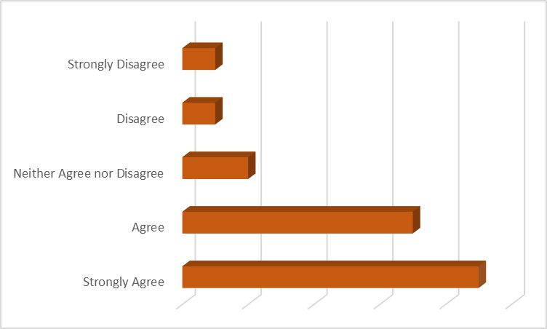

Slide 7
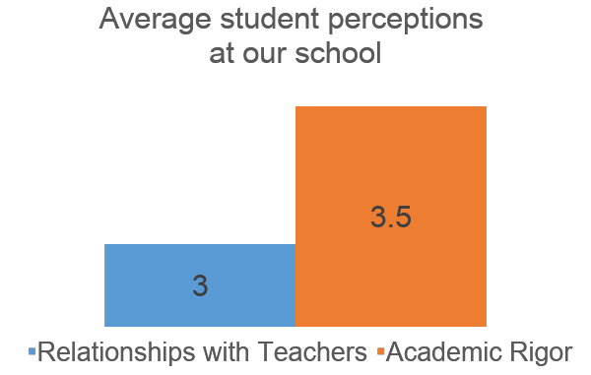

Slide 8
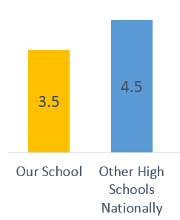
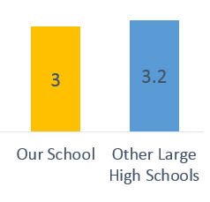
Relationships with Teachers
Academic Rigor

Slide 9
“I really feel like part of my school’s community.”

Slide 10
“I really feel like part of my school’s community.”

Slide 11
What makes student perception data actionable?
Quick turnaround
Valid and reliable questions
Meaningful comparisons
-Across different schools
-Across different student demographics

Slide 12
Amens. Epiphanies. Questions. Feedback.
“I liked…”
“I learned…”
“I wonder…”
“I suggest…”

Slide 13
Dr. Jennifer Bethman
Assistant Superintendent of Secondary Schools
Bethel School District, WA

Slide 14
Who did we hear from?
11,851 STUDENTS
4,152 elementary
3,921 middle
3,778 high school
3,854 FAMILIES
1,501 elementary parents
1,640 middle school parents
713 high school parents
1,355 STAFF
745 elementary staff
285 middle school staff
325 high school staff
Over 17,000
Bethel Community Members!

Slide 15
Strategic Plan
World’s largest coral reef system
Safety & Bullying
Academic Rigor
School Culture
College & Career Readiness

Slide 16
GOAL 2
All Students: Empowered, Safe, Supported and Connected
2a: Increased percentage of students indicating that his or her school is a socially, emotionally, and physically safe environment.
2b: Increased percentage of students connected in healthy, constructive relationships with peers and adults.

Slide 17
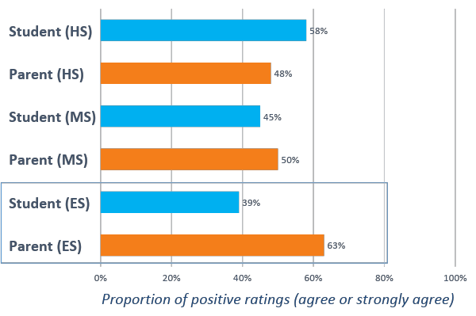
I have not been bullied this year
My child is safe from bullying
Bullying

Slide 18
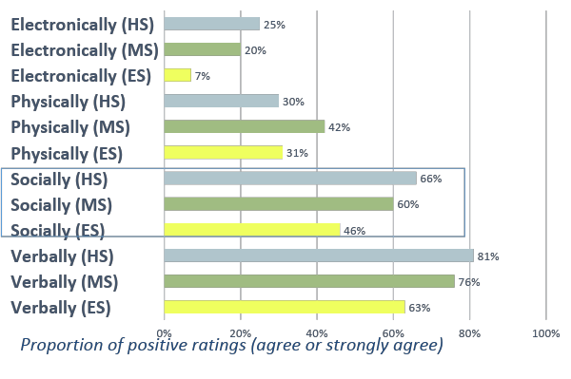
If you have been bullied, how did it happen?
Bullying: How it happened
Electronically: text, Facebook, email, or other social media.
Physically: pushed, tripped, hit; had belongings taken of broken on purpose.
Socially: purposefully not spoken to by other students.
Verbally: called names, made fun of, embarrassed, or threatened.

Slide 19
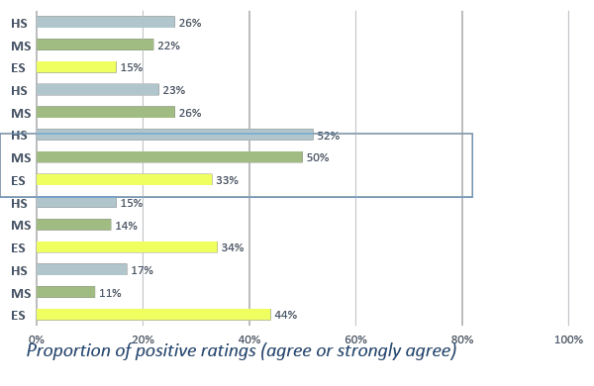
Why do you think you were bullied?
Bullying: Why it happened
Their race or skin color
Because people think they’re gay.
How they look
A disability that they have
Their sex or their gender

Slide 20
GOAL 3
Continuous Growth and Achievement in All Subjects
3a: Increase percentage meeting or exceeding proficiency standards on local state and national assessments
3c: Increased percentage of students who strategically use digital tools and resources to enhance learning
3d: Increased student ability to use feedback, engage in self-assessment, and set goals related to their learning.

Slide 21
World’s largest coral reef system
Elementary Rigor
3a: Increase percentage meeting or exceeding proficiency standards on local state and national assessments
93% of Elementary Students believe that their teacher wants them to work their hardest.
51% of Elementary Students believe that their work they do in class really makes them think.

Slide 22
World’s largest coral reef system
Secondary Rigor (Math + ELA)
3a: Increase percentage meeting or exceeding proficiency standards on local state and national assessments
56% of Middle School Students believe that their work they do in classes (at school in general) really makes them think.
When asked about Math classes, 71%
When asked about English classes, 61%
46% of High School Students believe that their work they do in classes (at school in general) really makes them think.
When asked about Math classes, 63%
When asked about English classes, 55%

Slide 23
World’s largest coral reef system
HS STEM: Use of Technology
3c: Increased percentage of students who strategically use digital tools and resources to enhance learning
I use technology in school to design solutions to problems (overall):
I use technology in school to design solutions to problems (across schools):

Slide 24
World’s largest coral reef system
Elementary (Locus of Control)
3d: Increased student ability to use feedback, engage in self-assessment, and set goals related to their learning.

Slide 25
GOAL 4
Equitable Opportunities for All Students
4a: Equitable access to and achievement in rigorous academic courses and programs
4c: Elimination of disproportionality in suspensions and expulsion rates for all student groups.
4d: Increased equitable access to social-emotional support services such as counseling and mental health.

Slide 26
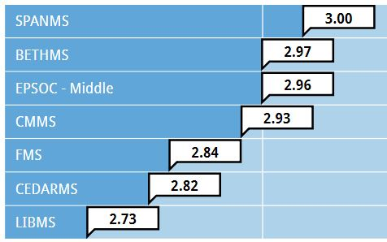
World’s largest coral reef system
Secondary Discipline & Fairness
4c: Elimination of disproportionality in suspensions and expulsion rates for all student groups.
“Discipline at my school is fair.”
←Middle
High:

Slide 27
World’s largest coral reef system
Secondary Discipline & Fairness
4c: Elimination of disproportionality in suspensions and expulsion rates for all student groups.
“Discipline at my school is fair.”
Middle School (Race/Ethnicity)

Slide 28
GOAL 5
Prepared for Success in Post-Secondary Education, Career and Life
5c: Increased high school graduation rates for ALL students
5d: Increased percentage of students engaging in post-secondary education at technical, two-year and four-year schools

Slide 29
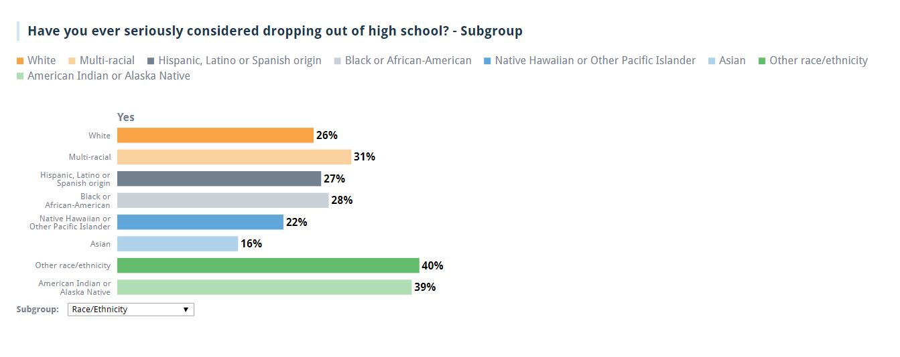
World’s largest coral reef system
Drop Out Risk

Slide 30
Amens. Epiphanies. Questions. Feedback.
“I liked…”
“I learned…”
“I wonder…”
“I suggest…”

Slide 31
Karen Hickman
Deputy Superintendent of Academic Achievement
Pasadena Independent School District, TX

Slide 32
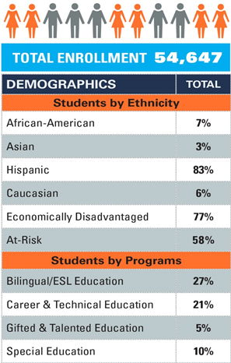
82%

Slide 33
Personalized Learning
Student Outcomes:
Thinking skills (Cognitive Skills)
Information (Content Knowledge)
Positive habits (Habits of Success)
Our goal: Students will be empowered to become accomplished, self-directed, collaborative, lifelong learners.

Slide 34
Personalized Learning
Project Based Learning
70% of Class Time
Real World Projects
Develop Thinking Skills
Deepen knowledge of content at the application level
Self Directed Learning
Basic knowledge and content information for the course
Practice working independently – setting goals, making action plans and reflecting
Choose the best resource for their learning style
One-to-One Mentoring
Focus on Relationships
Develop positive habits that support social and emotional health

Slide 35
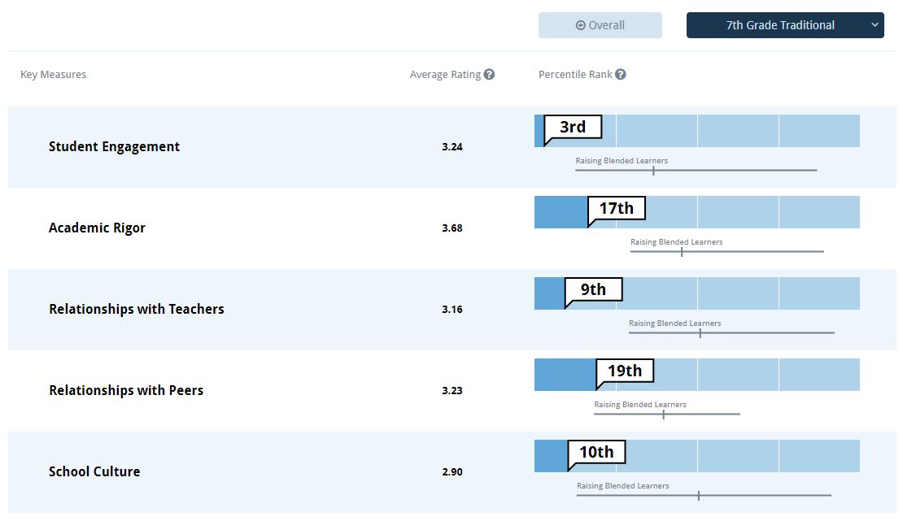
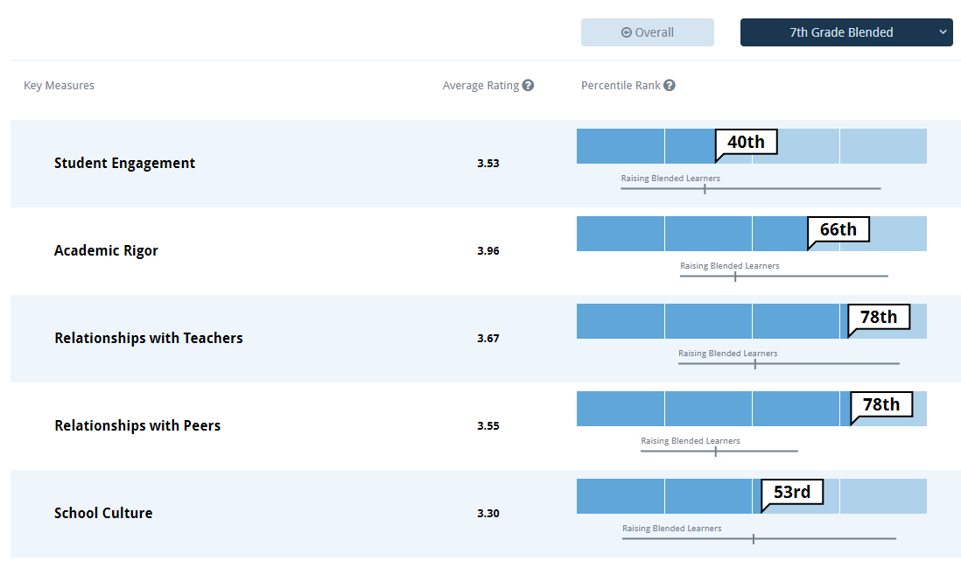
7th Grade Traditional vs.
7th Grade Personalized Learning

Slide 36
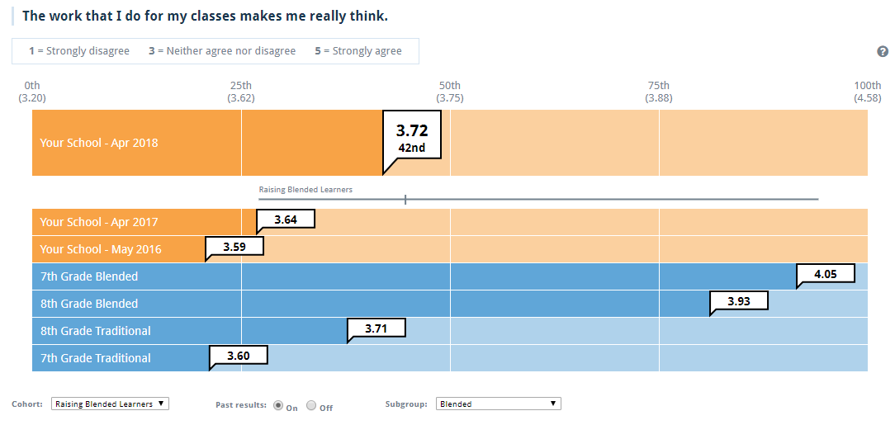
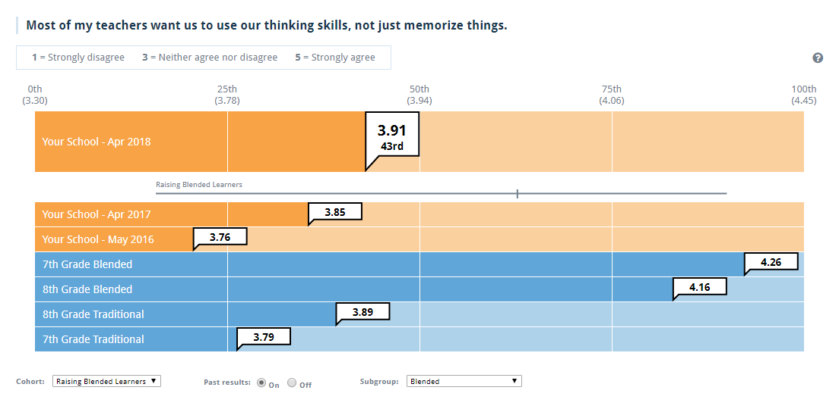
Academic Rigor

Slide 37
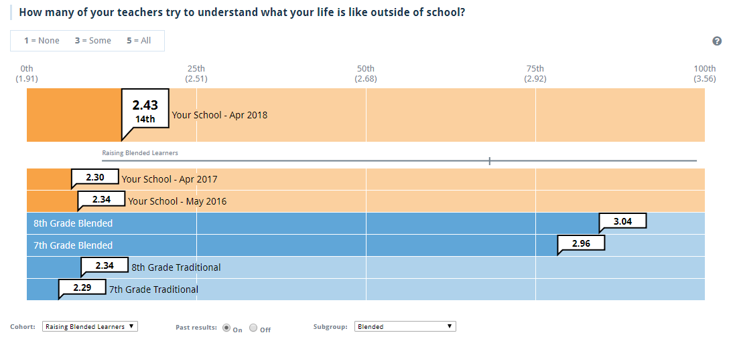
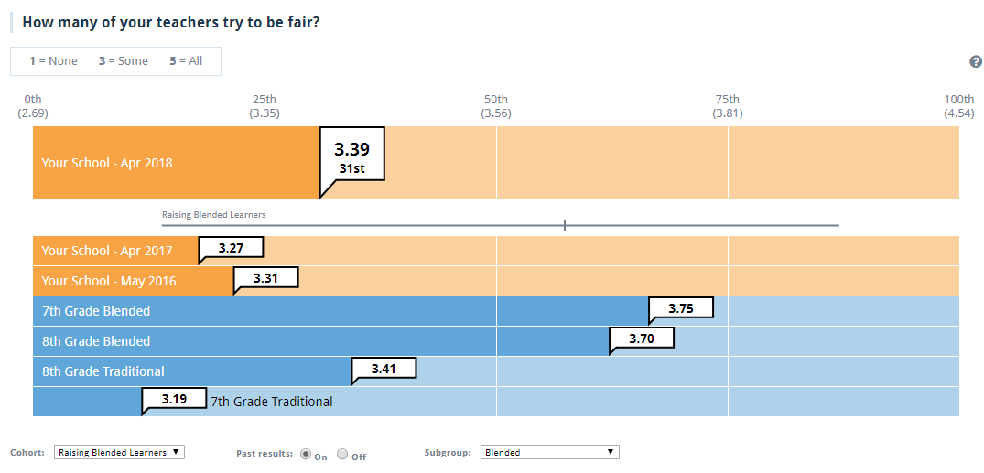
Relationships with Teachers

Slide 38
Data Informs Expansion
Stakeholders Include:
School Board Members
Central Office Administrators
Campus Administrators
Teachers
Community
Investors

Slide 39
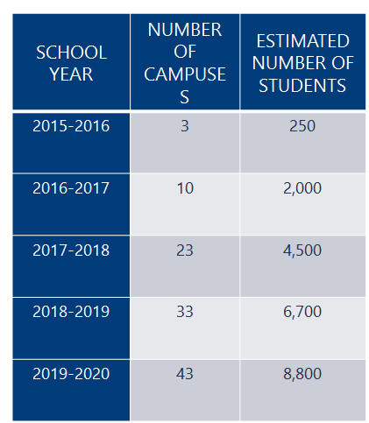
Expansion Plan

Slide 40
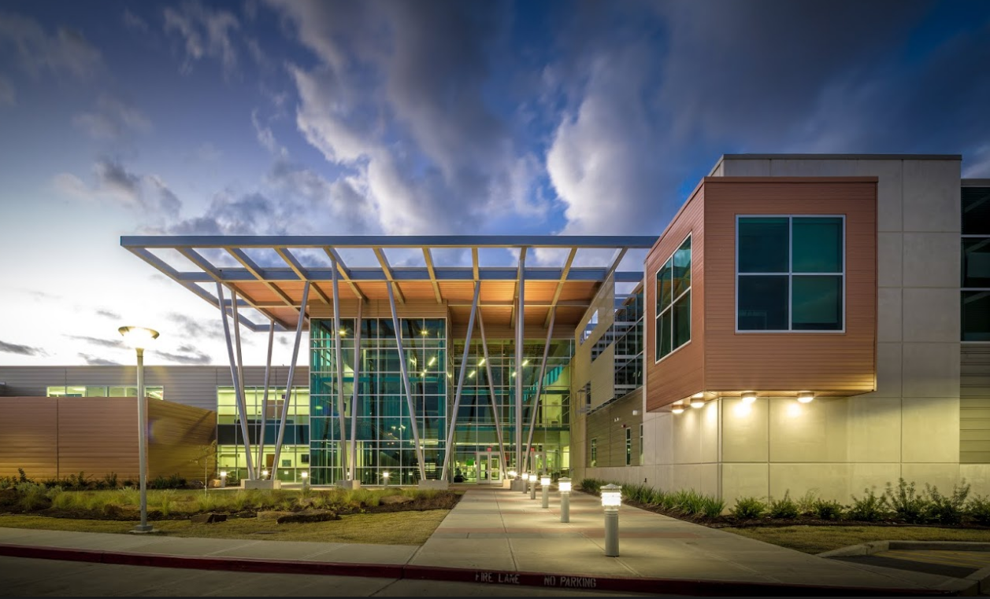
Dr. Kirk Lewis
Career and Technical High School
Pasadena I.S.D.
Pasadena, Texas

Slide 41
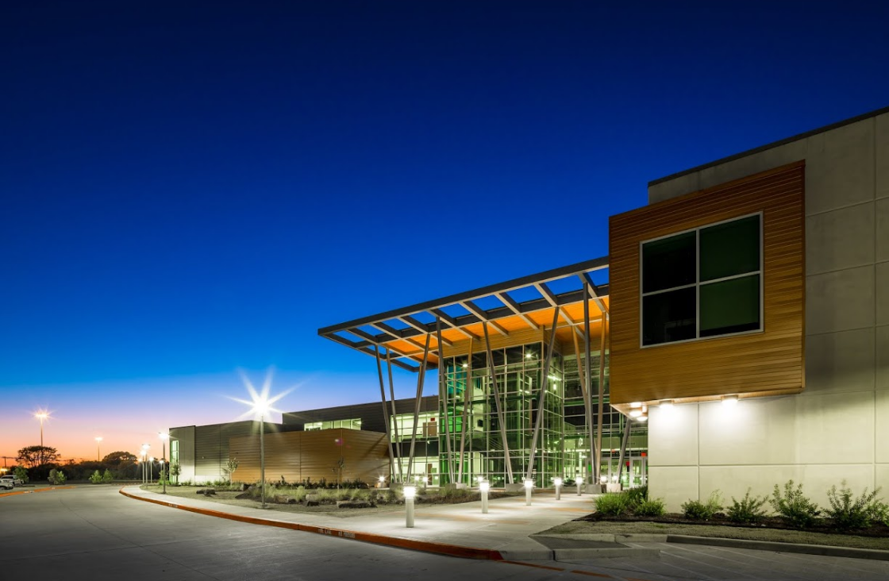
Our mission is to empower students to successfully transition to the global community through unique educational experiences.

Slide 42
CTHS is an application-based, high school of choice for students in Pasadena ISD.
High school Diploma
Industry-recognized Career & Technical Certification
College Hours
Community Service

Slide 43
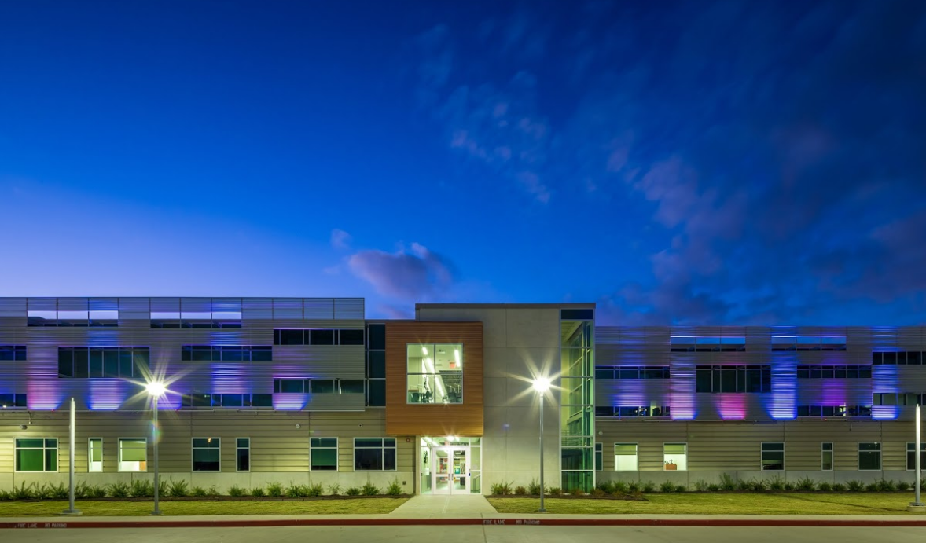
TRANSPORTATION ACADEMY
Auto Collision Repair
Automotive Technology
Maritime & Port Operations
HUMAN SERVICES ACADEMY
Business/Finance/Accounting
Child Guidance Management
Cosmetology
Criminal Justice
Culinary Arts
CONSTRUCTION & MANUFACTURING ACADEMY
Construction Technology
Electrical & Instrumentation Technology
Welding
AGRICULTURE ACADEMY
Veterinary Assistant
TECHNOLOGY ACADEMY
Audio/Video Production
Computer Maintenance
Computer Networking
Digital Graphics
Engineering & Robotics
HEALTH SCIENCES ACADEMY
Certified Nursing Assistant
Dental Assisting
Emergency Medical Technician
Pharmacy Technician

Slide 44
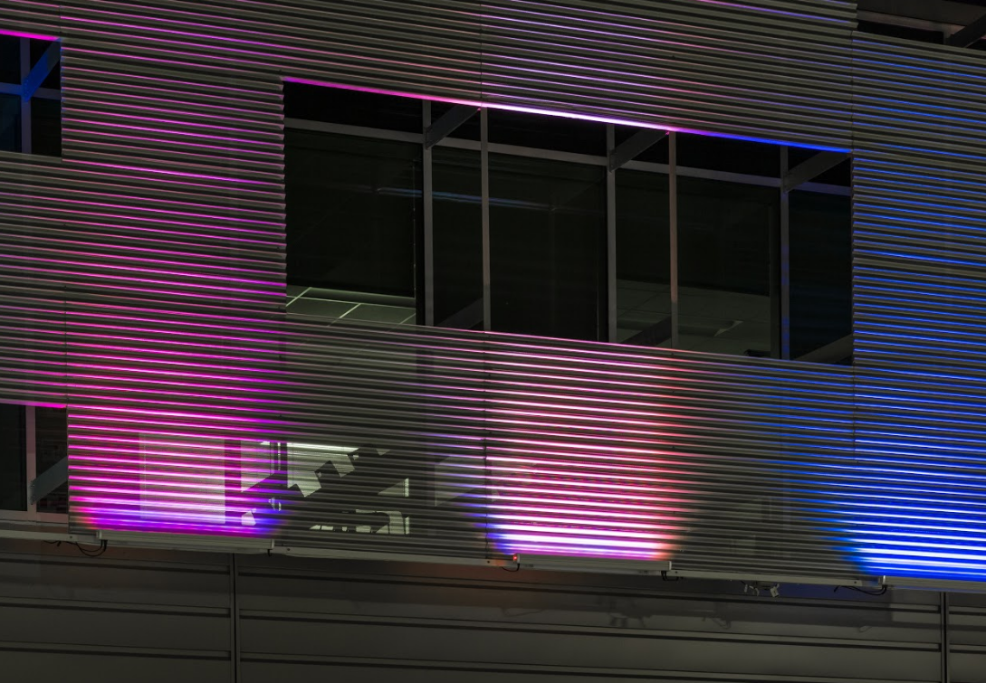
Students enrolled for full day instruction in core, elective, and CTE pathway courses at CTHS
1404 students in Grades 9-12

Slide 45
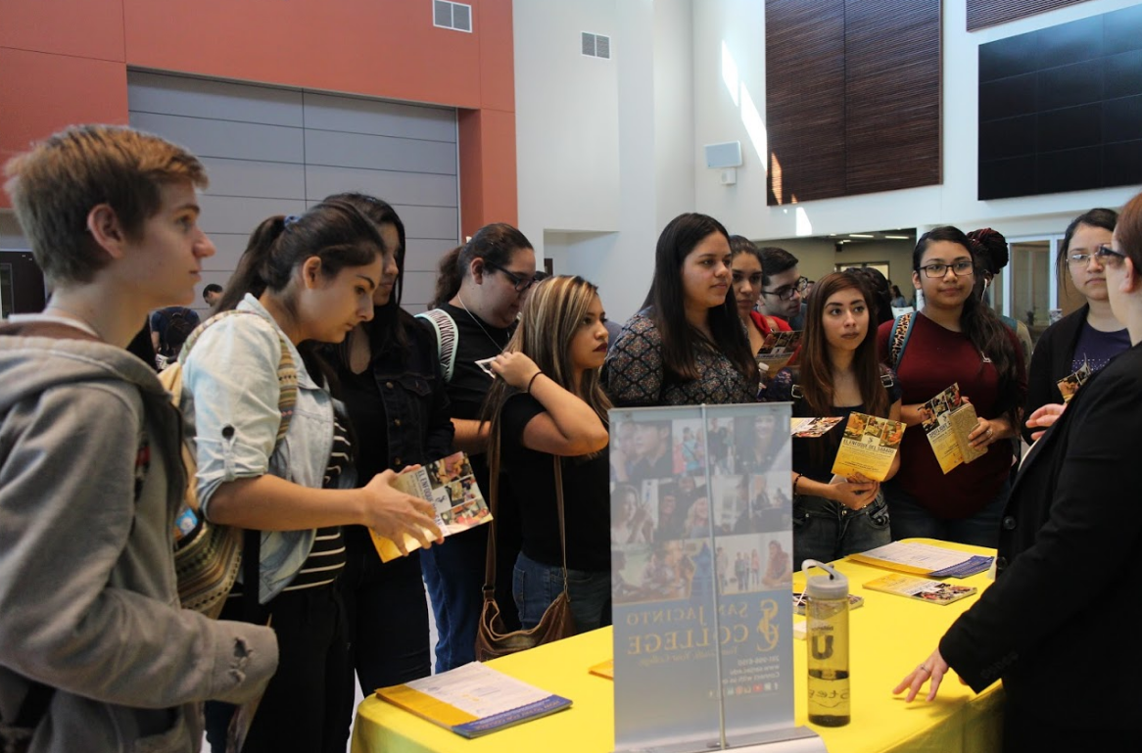
7% Special Education
8% LEP
78% Econ. Disadvantaged
77% At Risk
99% CTE Coherent Sequence
85% Hispanic
9% Anglo
4% African American
2% Asian

Slide 46
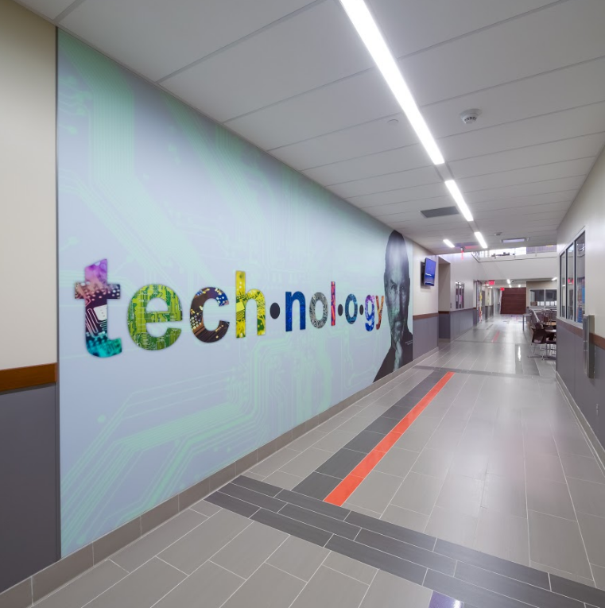

Slide 47
Youth Truth
Summary
Results
for CTHS

Slide 51
Our Campus
Our Cohort
Nationally

Slide 52
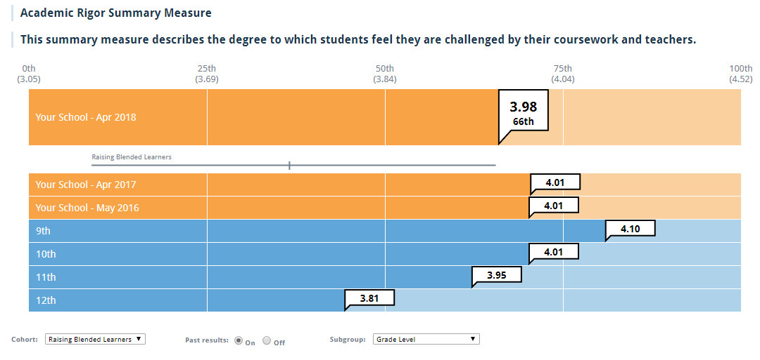
Grade Level Comparative Data

Slide 53
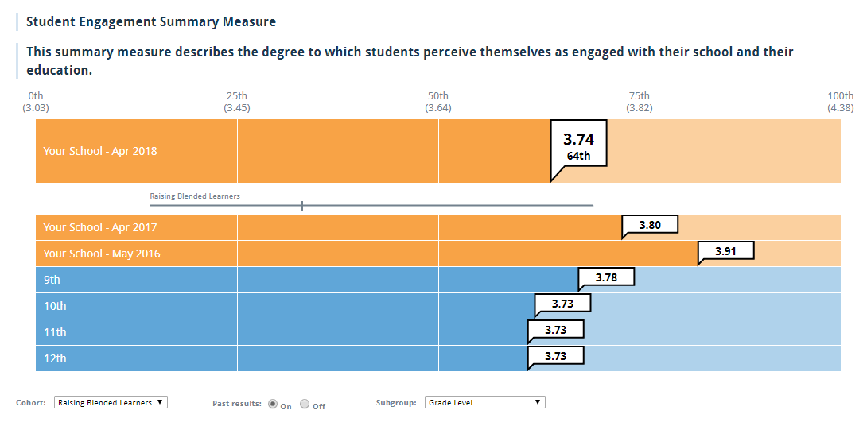
Year to Year Comparative Data

Slide 54
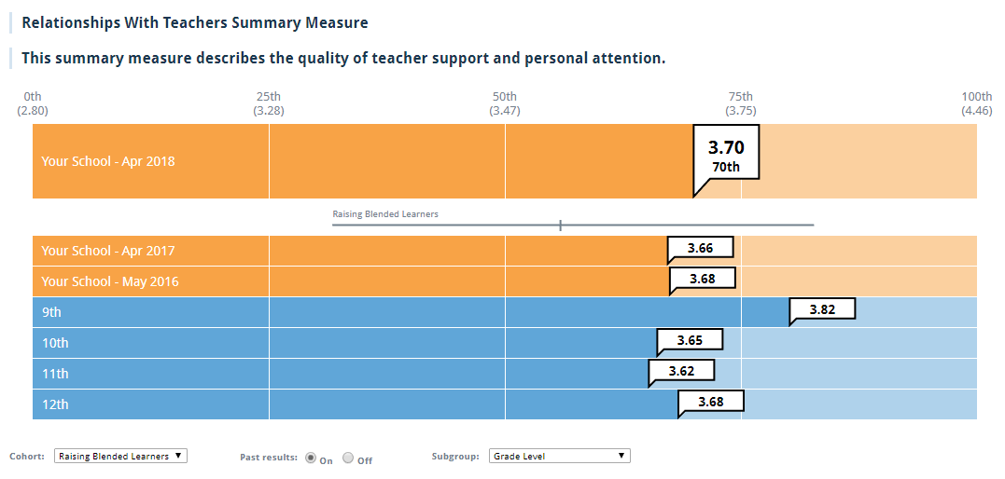
Cohort Comparative Data

Slide 55
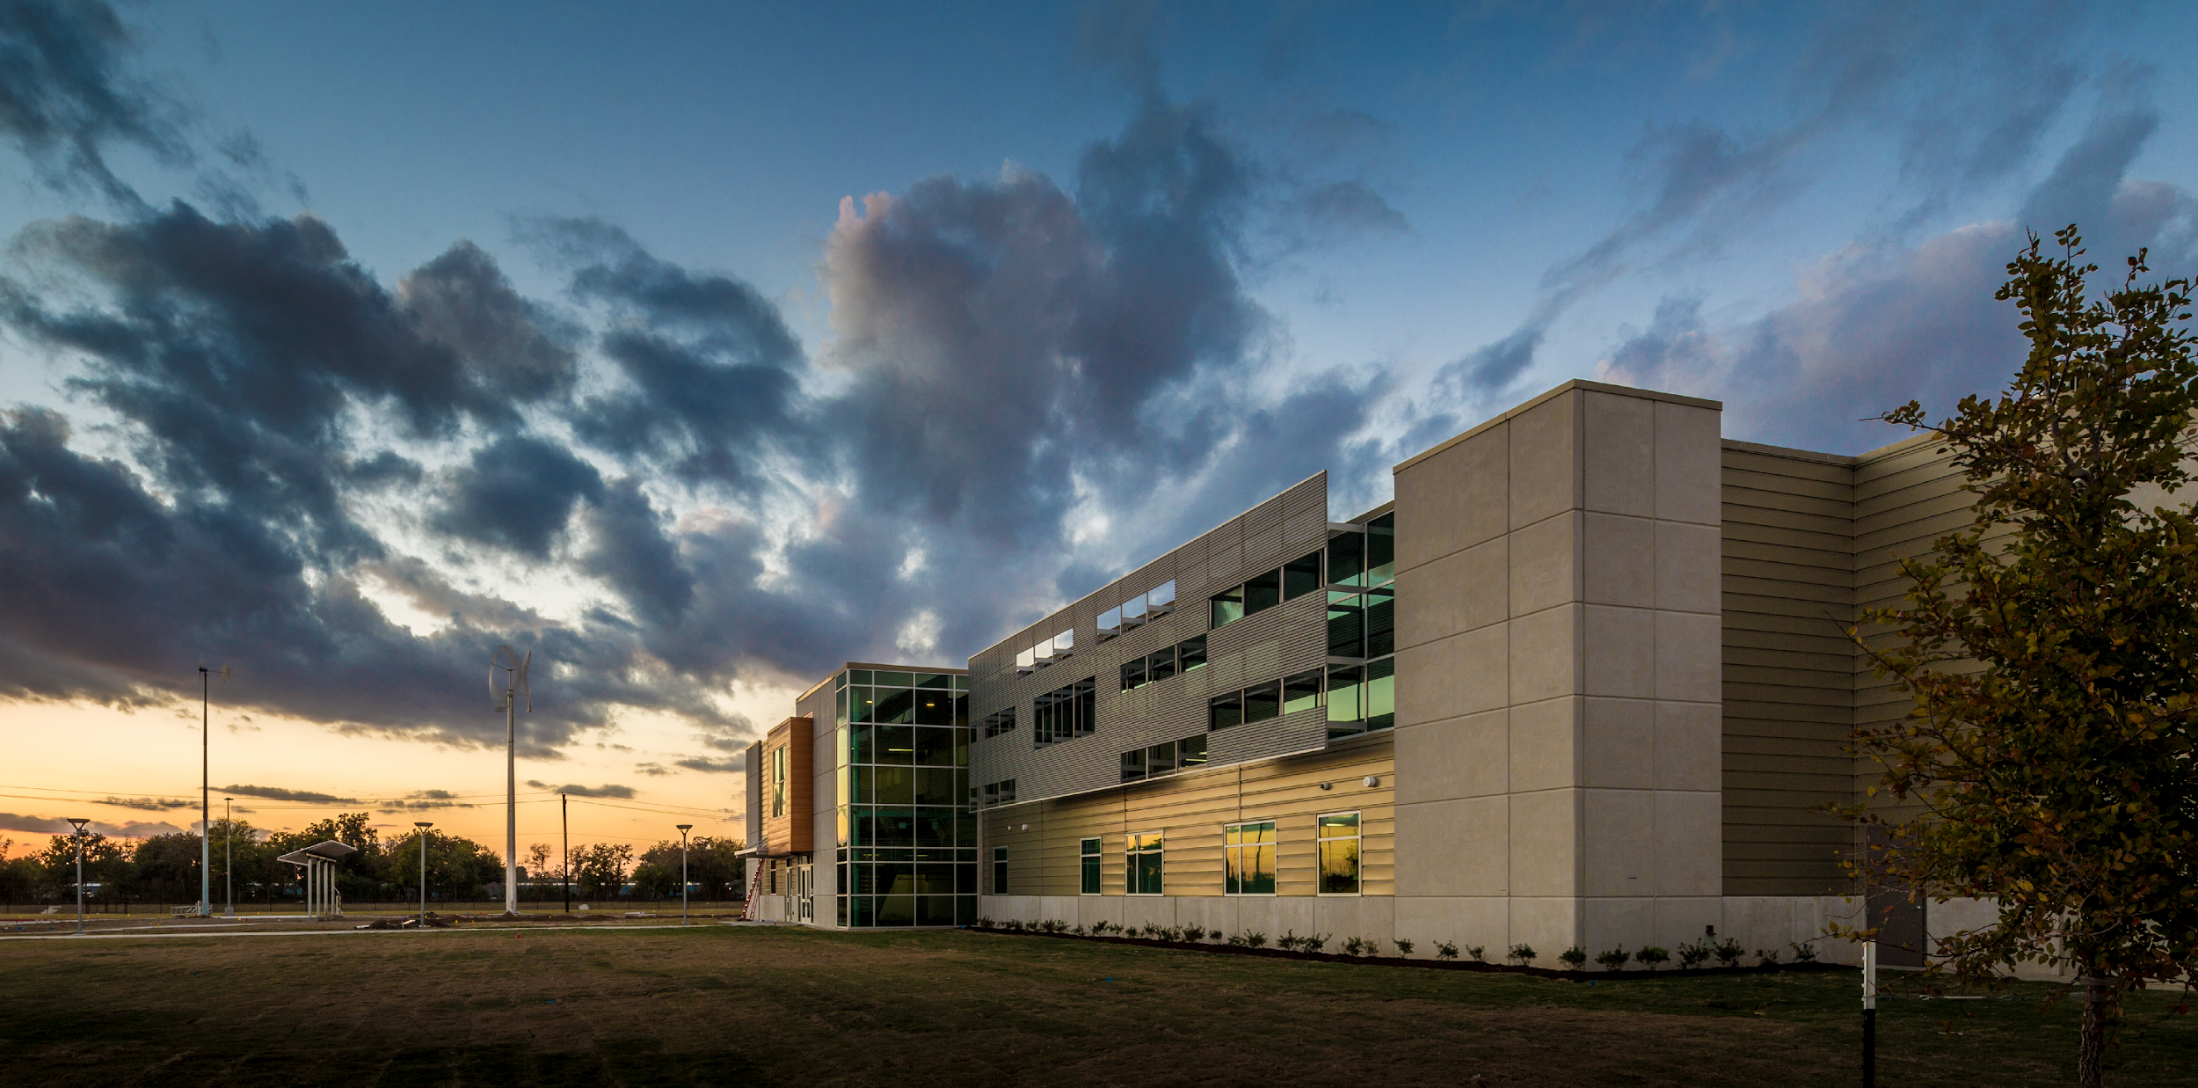
Actions Using Survey Data

Slide 56
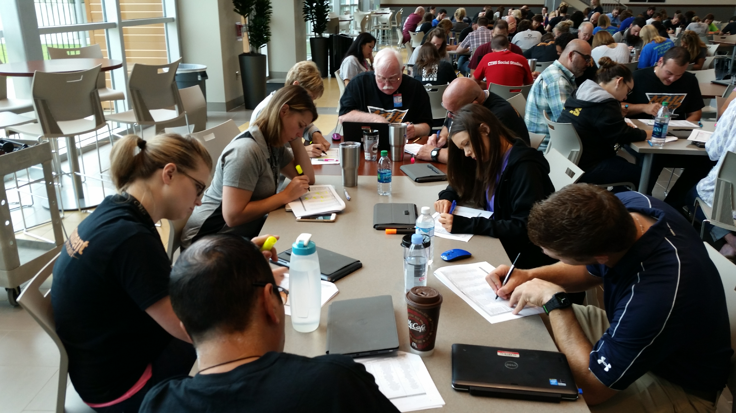
Interdisciplinary Teams Reviewing YT Data

Slide 57
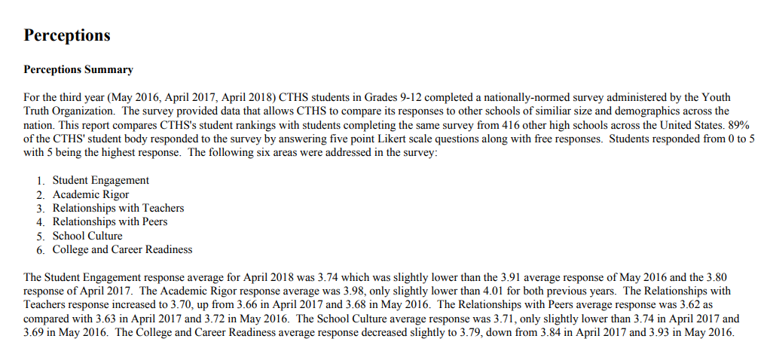
Campus Improvement Plans

Slide 58
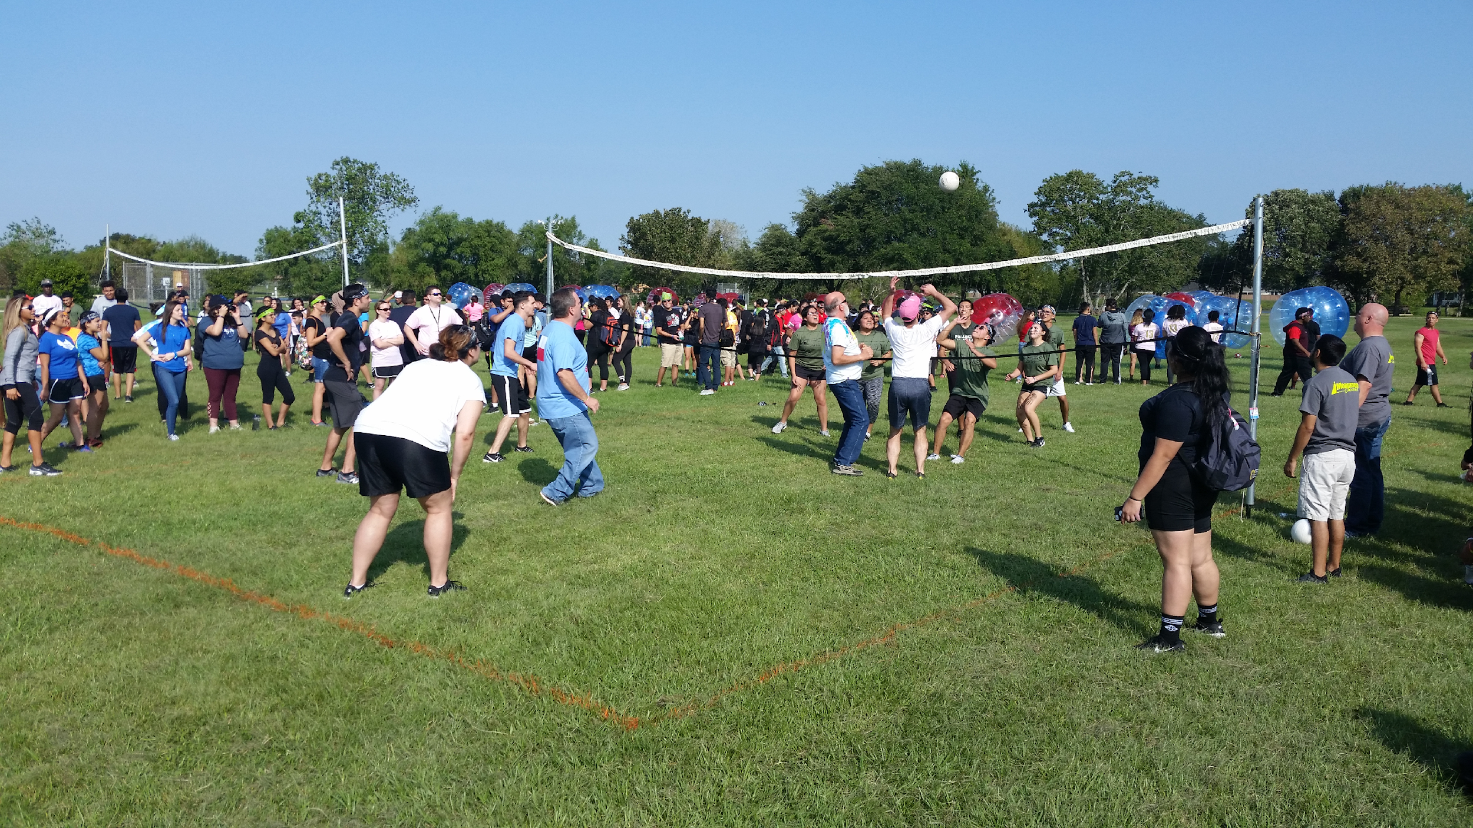
Teacher-Student Relationships

Slide 59
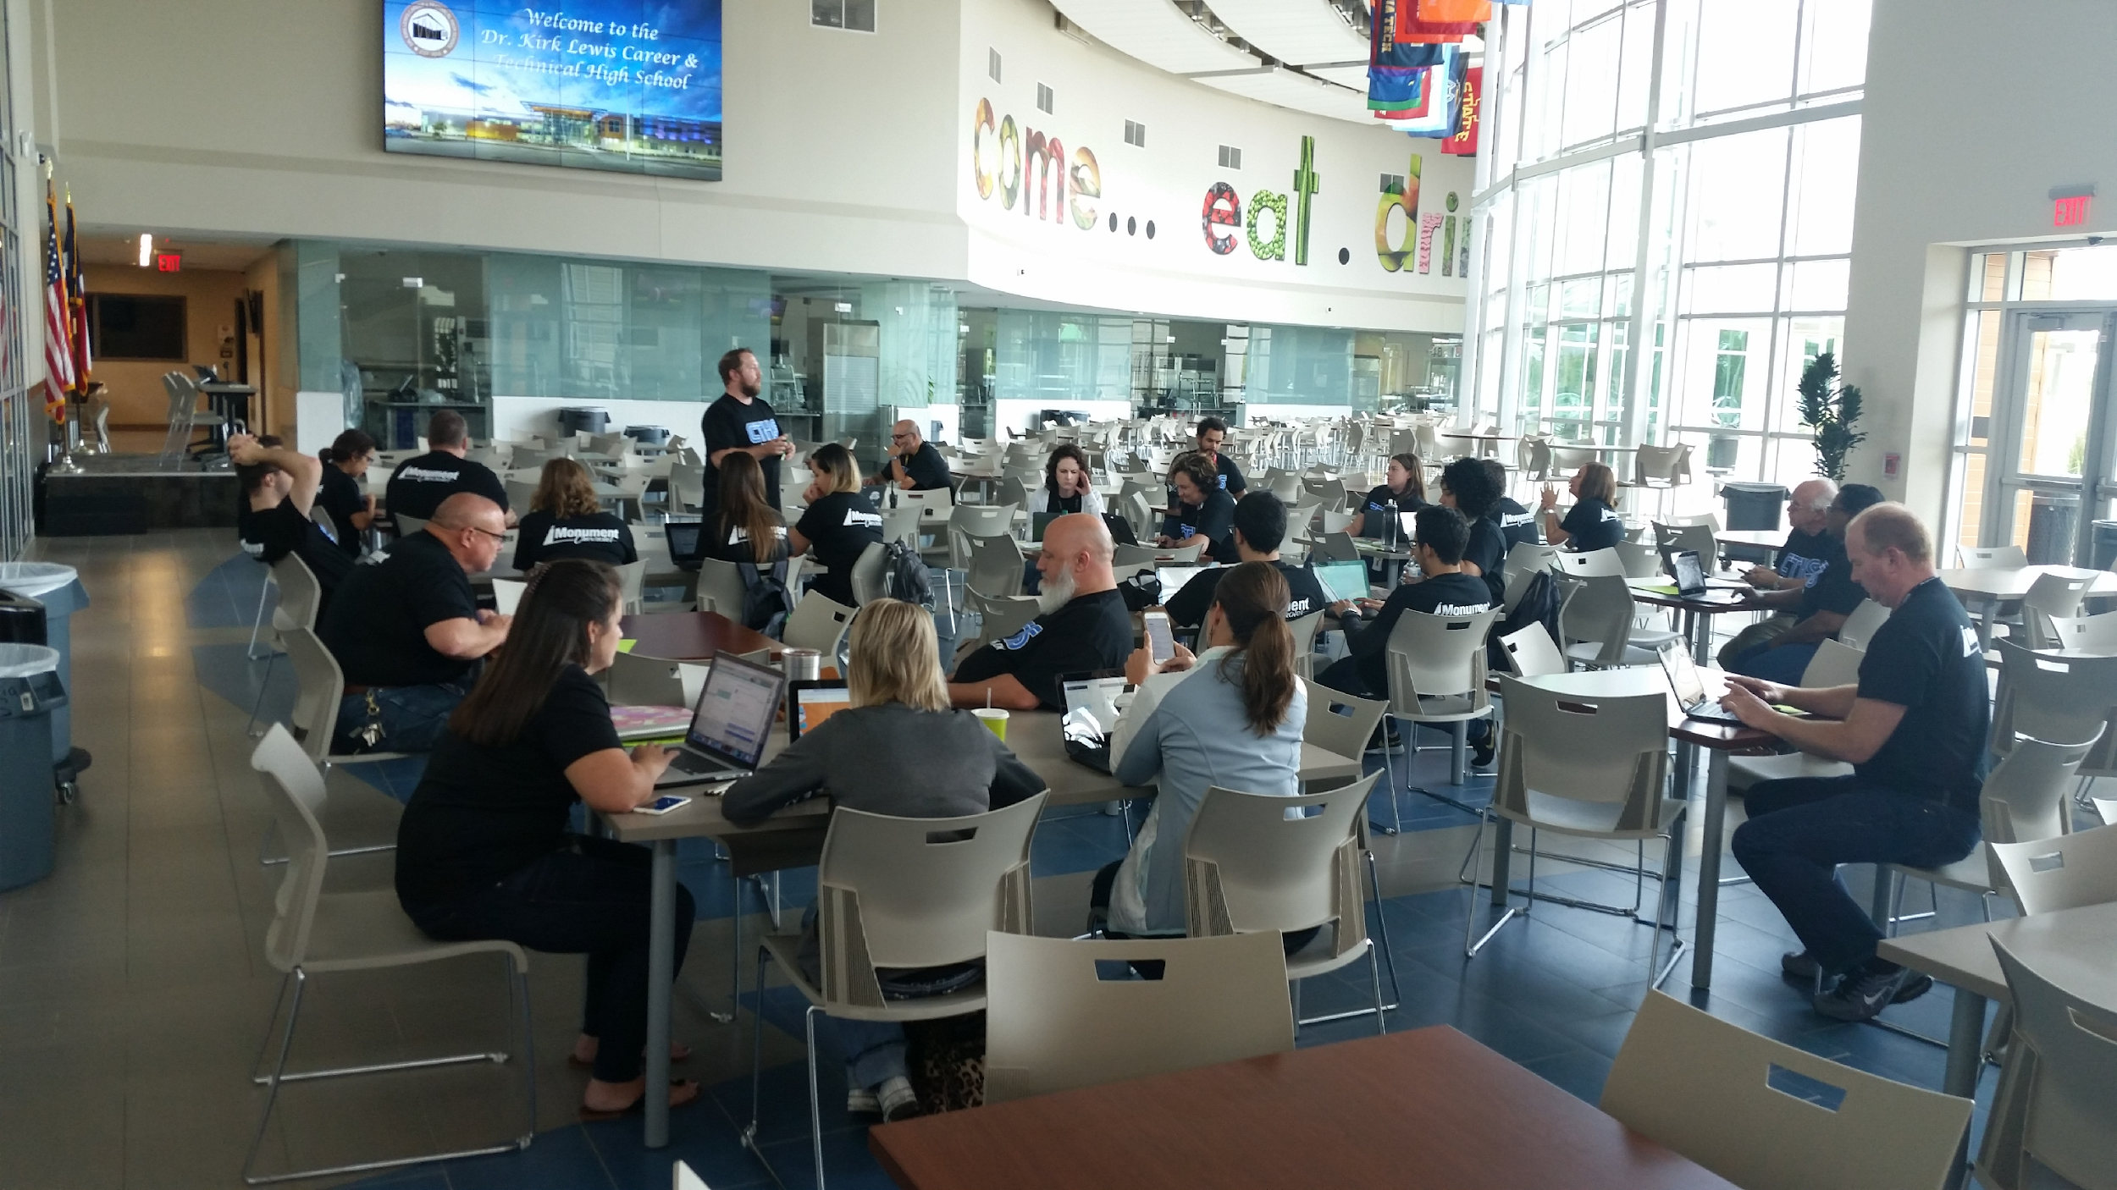
Staff Development & Training

Slide 60
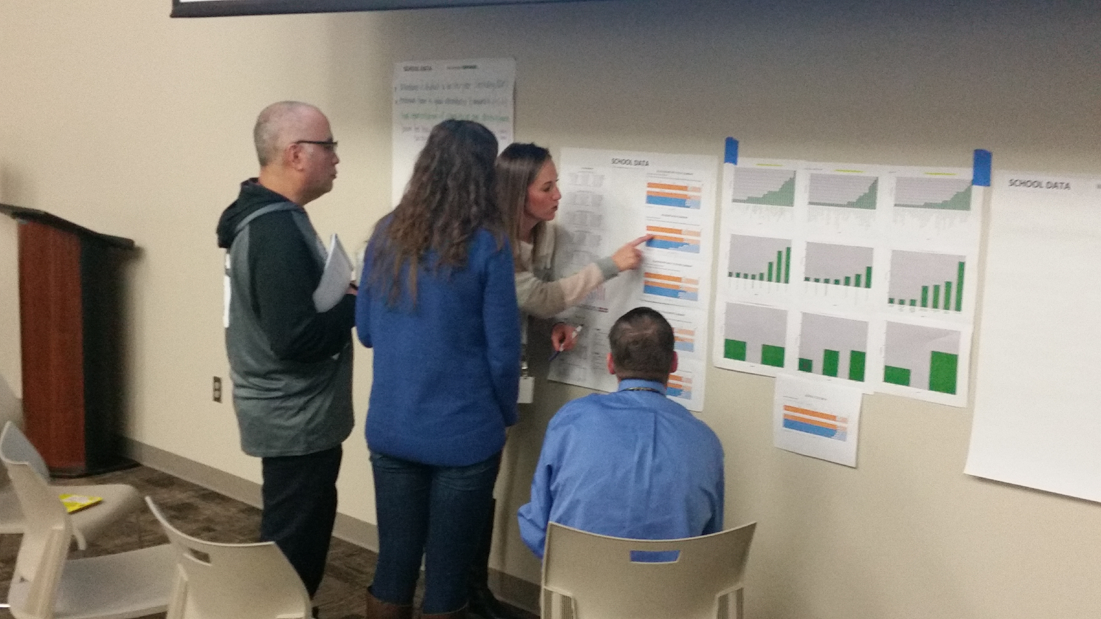
5 Year Action Planning

Slide 61
Amens. Epiphanies. Questions. Feedback.
“I liked…”
“I learned…”
“I wonder…”
“I suggest…”

Slide 62
Great Valley School District
Student, Family, and Staff Survey Results

Slide 63
We heard from over 4,500
Great Valley Community Members
363 staff about perceptions of their local school
1,115 parents and guardians about their child’s school
3,105 students about their school and classroom experience

Slide 64
What were the core themes of the surveys?
STUDENT
Engagement
Culture
Relationships
Academic Rigor / Academic Expectations
[If High School: College & Career Readiness]
[If Elementary: Instructional Methods (Elementary only)
FAMILY
Engagement & Empowerment
Culture
Relationships
Communication & Feedback
Safety
Resources & Facilities
STAFF
Engagement & Empowerment
Culture & Communication
Relationships
Communication & Feedback
Professional Development & Support

Slide 65
Celebrations
Teachers Build Strong Relationships with Students– Students are overwhelmingly positive about their teachers showing them respect, being willing to give extra help on schoolwork when needed, and treating students fairly.
Students Report Positive School Culture– Students agree that their peers are friendly to them, behave well in class, and they collaborate on schoolwork together.
Families Feel Respected and Welcomed– Compared to other schools across the country, Great Valley families are more likely to say that their school creates a friendly environment.

Slide 66
Priorities for Change
Improve Communication with Staff – Staff want to feel more informed about/involved in important decisions regarding their school.
More Tailored Professional Development- Staff report a need for more professional development that provides them with content support.
Increase Awareness of College and Career Resources– While seniors reported feeling more prepared for applying for college and pursuing careers, younger students were less aware of the resources offered.

Slide 67
We’ve already…
Debriefed the results with Administrators, Staff, and Student Leaders
Conducted Focus Groups with Staff
Used data with the Professional Development Committee (Comprehensive Plan)

Slide 68
Amens. Epiphanies. Questions. Feedback.
“I liked…”
“I learned…”
“I wonder…”
“I suggest…”

Slide 69
Dr. Jennifer Bethman, Assistant Superintendent of Secondary Schools,
Bethel School District, WA
Steve Fleming, Principal, Pasadena Independent School District, TX
Karen Hickman, Deputy Superintendent of Academic Achievement,
Pasadena Independent School District, TX
Dr. Regina Speaker Palubinsky, Superintendent, Great Valley School District, PA
Jimmy Simpson Jr., Partnerships, YouthTruth Student Survey
jimmys@youthtruthsurvey.org
(415) 510-2639

