Slide 1
Turning Student Feedback into Action: Two District Approaches
Greg Harris, Principal of Rowe Middle School, North Clackamas
Libby Miller, Executive Director of Middle Schools, North Clackamas
Ryan Noss, Superintendent, Corvallis
Jimmy Simpson Jr., Partnerships, YouthTruth Student Survey

Slide 3
1. Turn to one person and introduce yourself
your name
your role
your organization
2. What do you need to know in order to use student feedback for continuous improvement?

Slide 4
Agenda
-Getting the most out of student feedback
-How does North Clackamas School District use their perception data to inform equity work in the district?
-How has Rowe Middle School used student voice to make change at their school?
-How has Corvallis School District engaged their communities in their feedback data?
-Questions? Epiphanies? Reflections?

Slide 5
What makes student perception data actionable?
Quick turnaround
Valid and reliable questions
Meaningful comparisons
-Across different schools
-Across different student demographics

Slide 6
Without validated instruments…
What did their answers mean?
Survey Students
In my school, a variety of resources are available to help me succeed (e.g., teaching staff, technology, media center).
You’re left with more questions than answers

Slide 7
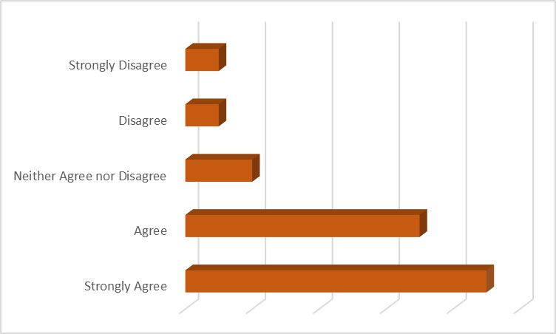

Slide 8
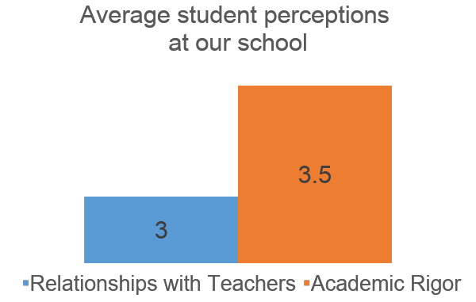

Slide 9
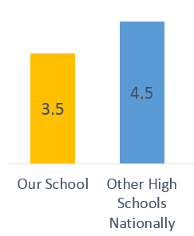
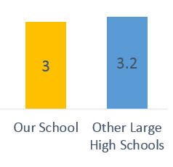
Relationships with Teachers
Academic Rigor

Slide 10
“I really feel like part of my school’s community.”

Slide 11
“I really feel like part of my school’s community.”

Slide 12
What makes student perception data actionable?
Quick turnaround
Valid and reliable questions
Meaningful comparisons
-Across different schools
-Across different student demographics

Slide 13
Amens. Epiphanies. Questions. Feedback.
“I liked…”
“I learned…”
“I wonder…”
“I suggest…”

Slide 15
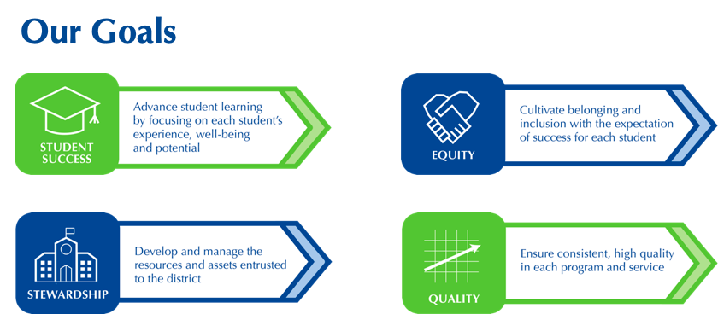

Slide 18
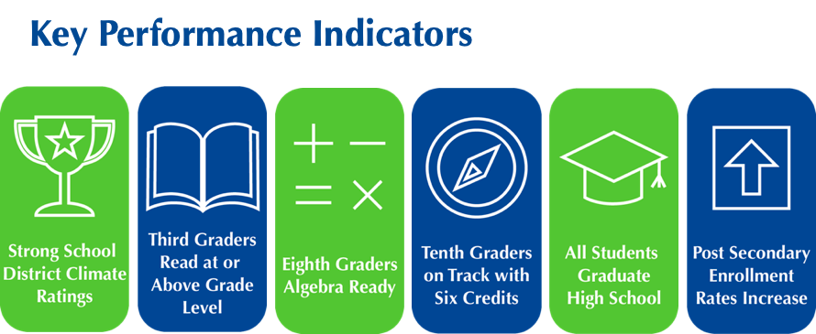

Slide 19
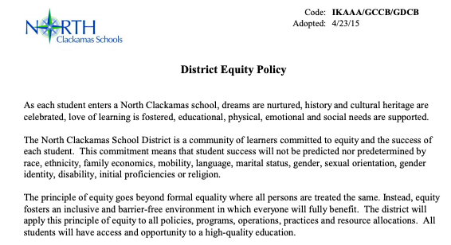

Slide 21
NCSD Equity Stance
As a North Clackamas community we:
· embrace and affirm the identity of each student inclusive of race, ethnicity, family economics, mobility, language, marital status, gender, sexual orientation, gender identity, disability, initial proficiencies, and religion.
· cultivate a school system where outcomes cannot be predicted based on a component of a student’s identity and where the achievement and graduation gap has closed between students from historically marginalized populations and those who have traditionally experienced success.
· know the work of identifying and removing systemic barriers that perpetuate disparities and disproportionate outcomes for students in historically marginalized groups is the responsibility of each person in our system.

Slide 22
Taking Action
Share data with all stakeholders. “We hear you” is a must.
Set goals based on the data, disaggregated student groups.
Monitor progress, report out, continue to take action.

Slide 23
Community and Government Relations
“We have changed our approach to communicating about racialized incidents in schools. When we have to send a letter to parents informing them of a racialized event, we make sure we call out the behavior and the language and not sugar coat the incident.”

Slide 24
Amens. Epiphanies. Questions. Feedback.
“I liked…”
“I learned…”
“I wonder…”
“I suggest…”

Slide 25
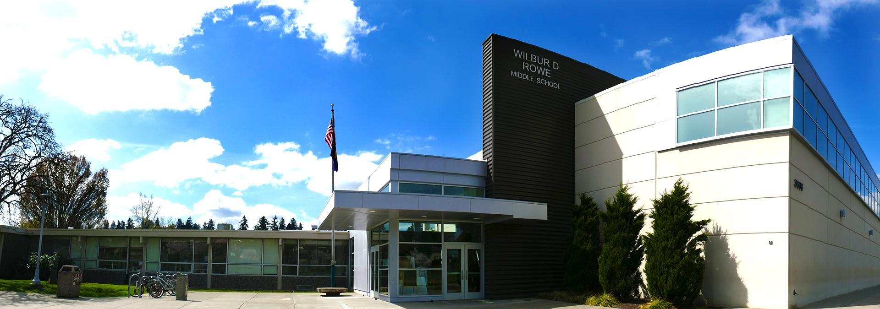
Rowe Middle School’s Story

Slide 26
Our Why:
Rowe’s Mission
Through meaningful relationships and challenging, exploratory, integrative, and relevant curriculum for each student and staff member, we prepare graduates who are inspired and empowered to strengthen the quality of life in our local and global communities.
Each student is known by NAME, STRENGTH, and NEED.
Each classroom is SAFE, CALM, and PREDICTABLE.

Slide 27
Our Why:
Rowe’s Mission
Through meaningful relationships and challenging, exploratory, integrative, and relevant curriculum for each student and staff member, we prepare graduates who are inspired and empowered to strengthen the quality of life in our local and global communities.
Each student is known by NAME, STRENGTH, and NEED.
Each classroom is SAFE, CALM, and PREDICTABLE.
“You can’t improve what you can’t measure.”

Slide 28
Our Path:
Timeline:
1st Survey: June, 2018
Incorporated into School Improvement Plan
Presented results to staff: October, 2018
2nd Survey: February, 2019
Presented results to staff: June, 2019
Used as a central data point for SIP planning

Slide 29
What’s Next?
Focus on a few areas for improvement.
Monitor long-term trends.
Refine our understanding and our students’ understanding of the questions.
Use this as a springboard to more in-depth ways to get student perspectives.

Slide 30
Amens. Epiphanies. Questions. Feedback.
“I liked…”
“I learned…”
“I wonder…”
“I suggest…”

Slide 31
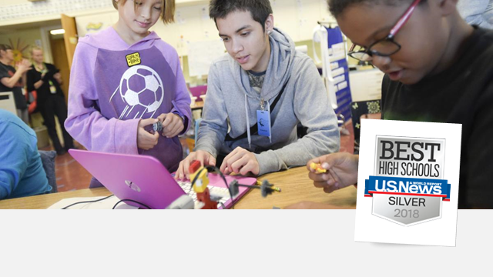

Slide 32
Board Goals
Goal 1. Student Achievement
Goal 2. Equitable Systems
Goal 3. Real-World Learning
Goal 4. Health & Wellness
Goal 5. Long Range Facility Planning
How do you measure progress and a return on investment?
How can we elevate student voice?

Slide 33
Goal 4. Health & Wellness
Improve the health and wellness of district students and staff. Student identity (race, culture, socioeconomic status, language, ability, gender, or sexual orientation) does not predict or predetermine success in school.

Slide 34
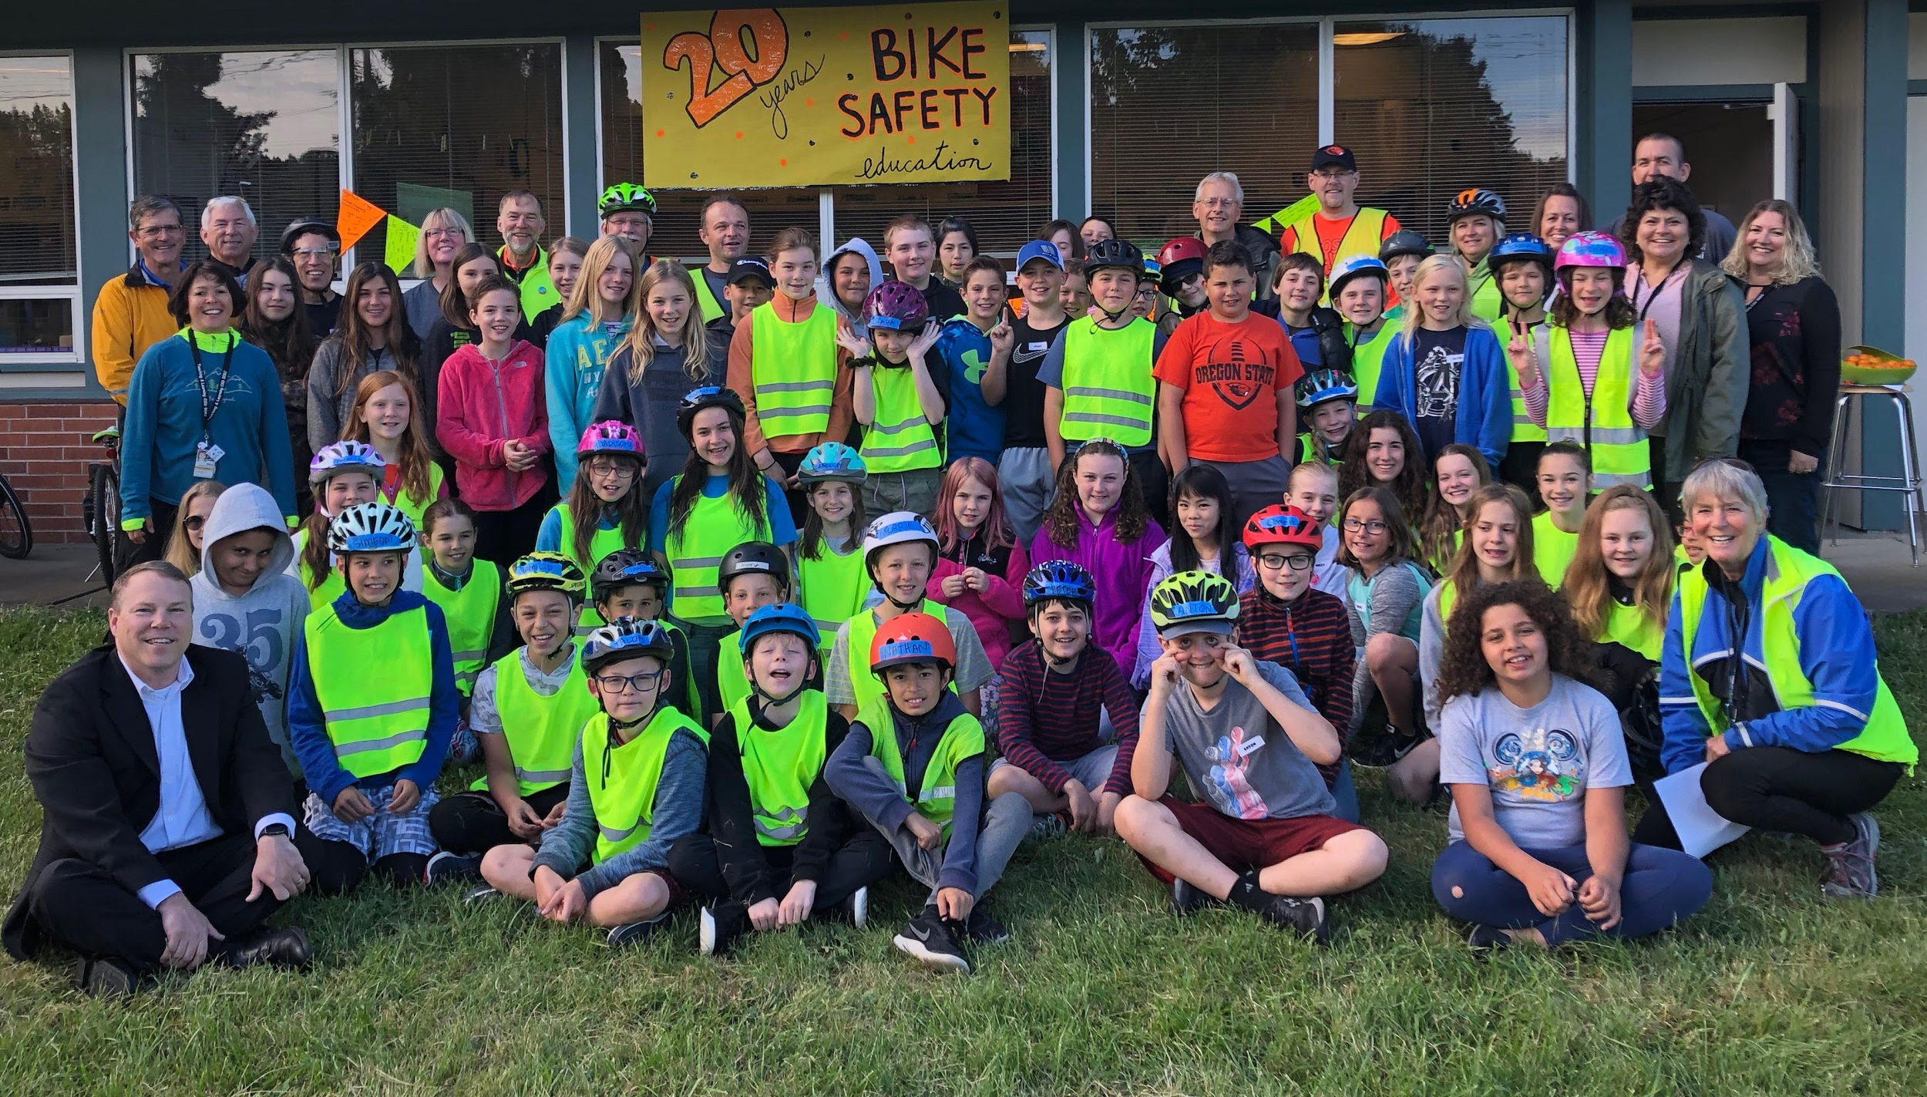
Strategies:
Support and enhance programs that promote student mental wellness and safety.
Support and enhance programs that promote student physical wellness and safety.
Support a robust worksite wellness program for district staff.

Slide 35
Relationships (High School)

Slide 36
School Culture (High School)

Slide 37
College & Career Readiness (High School)

Slide 38
College & Career Readiness (High School)
ata not found for enrolled in college at any time during the first two years after high school.
AVG = 79%

Slide 39
Engagement (High School)

Slide 40
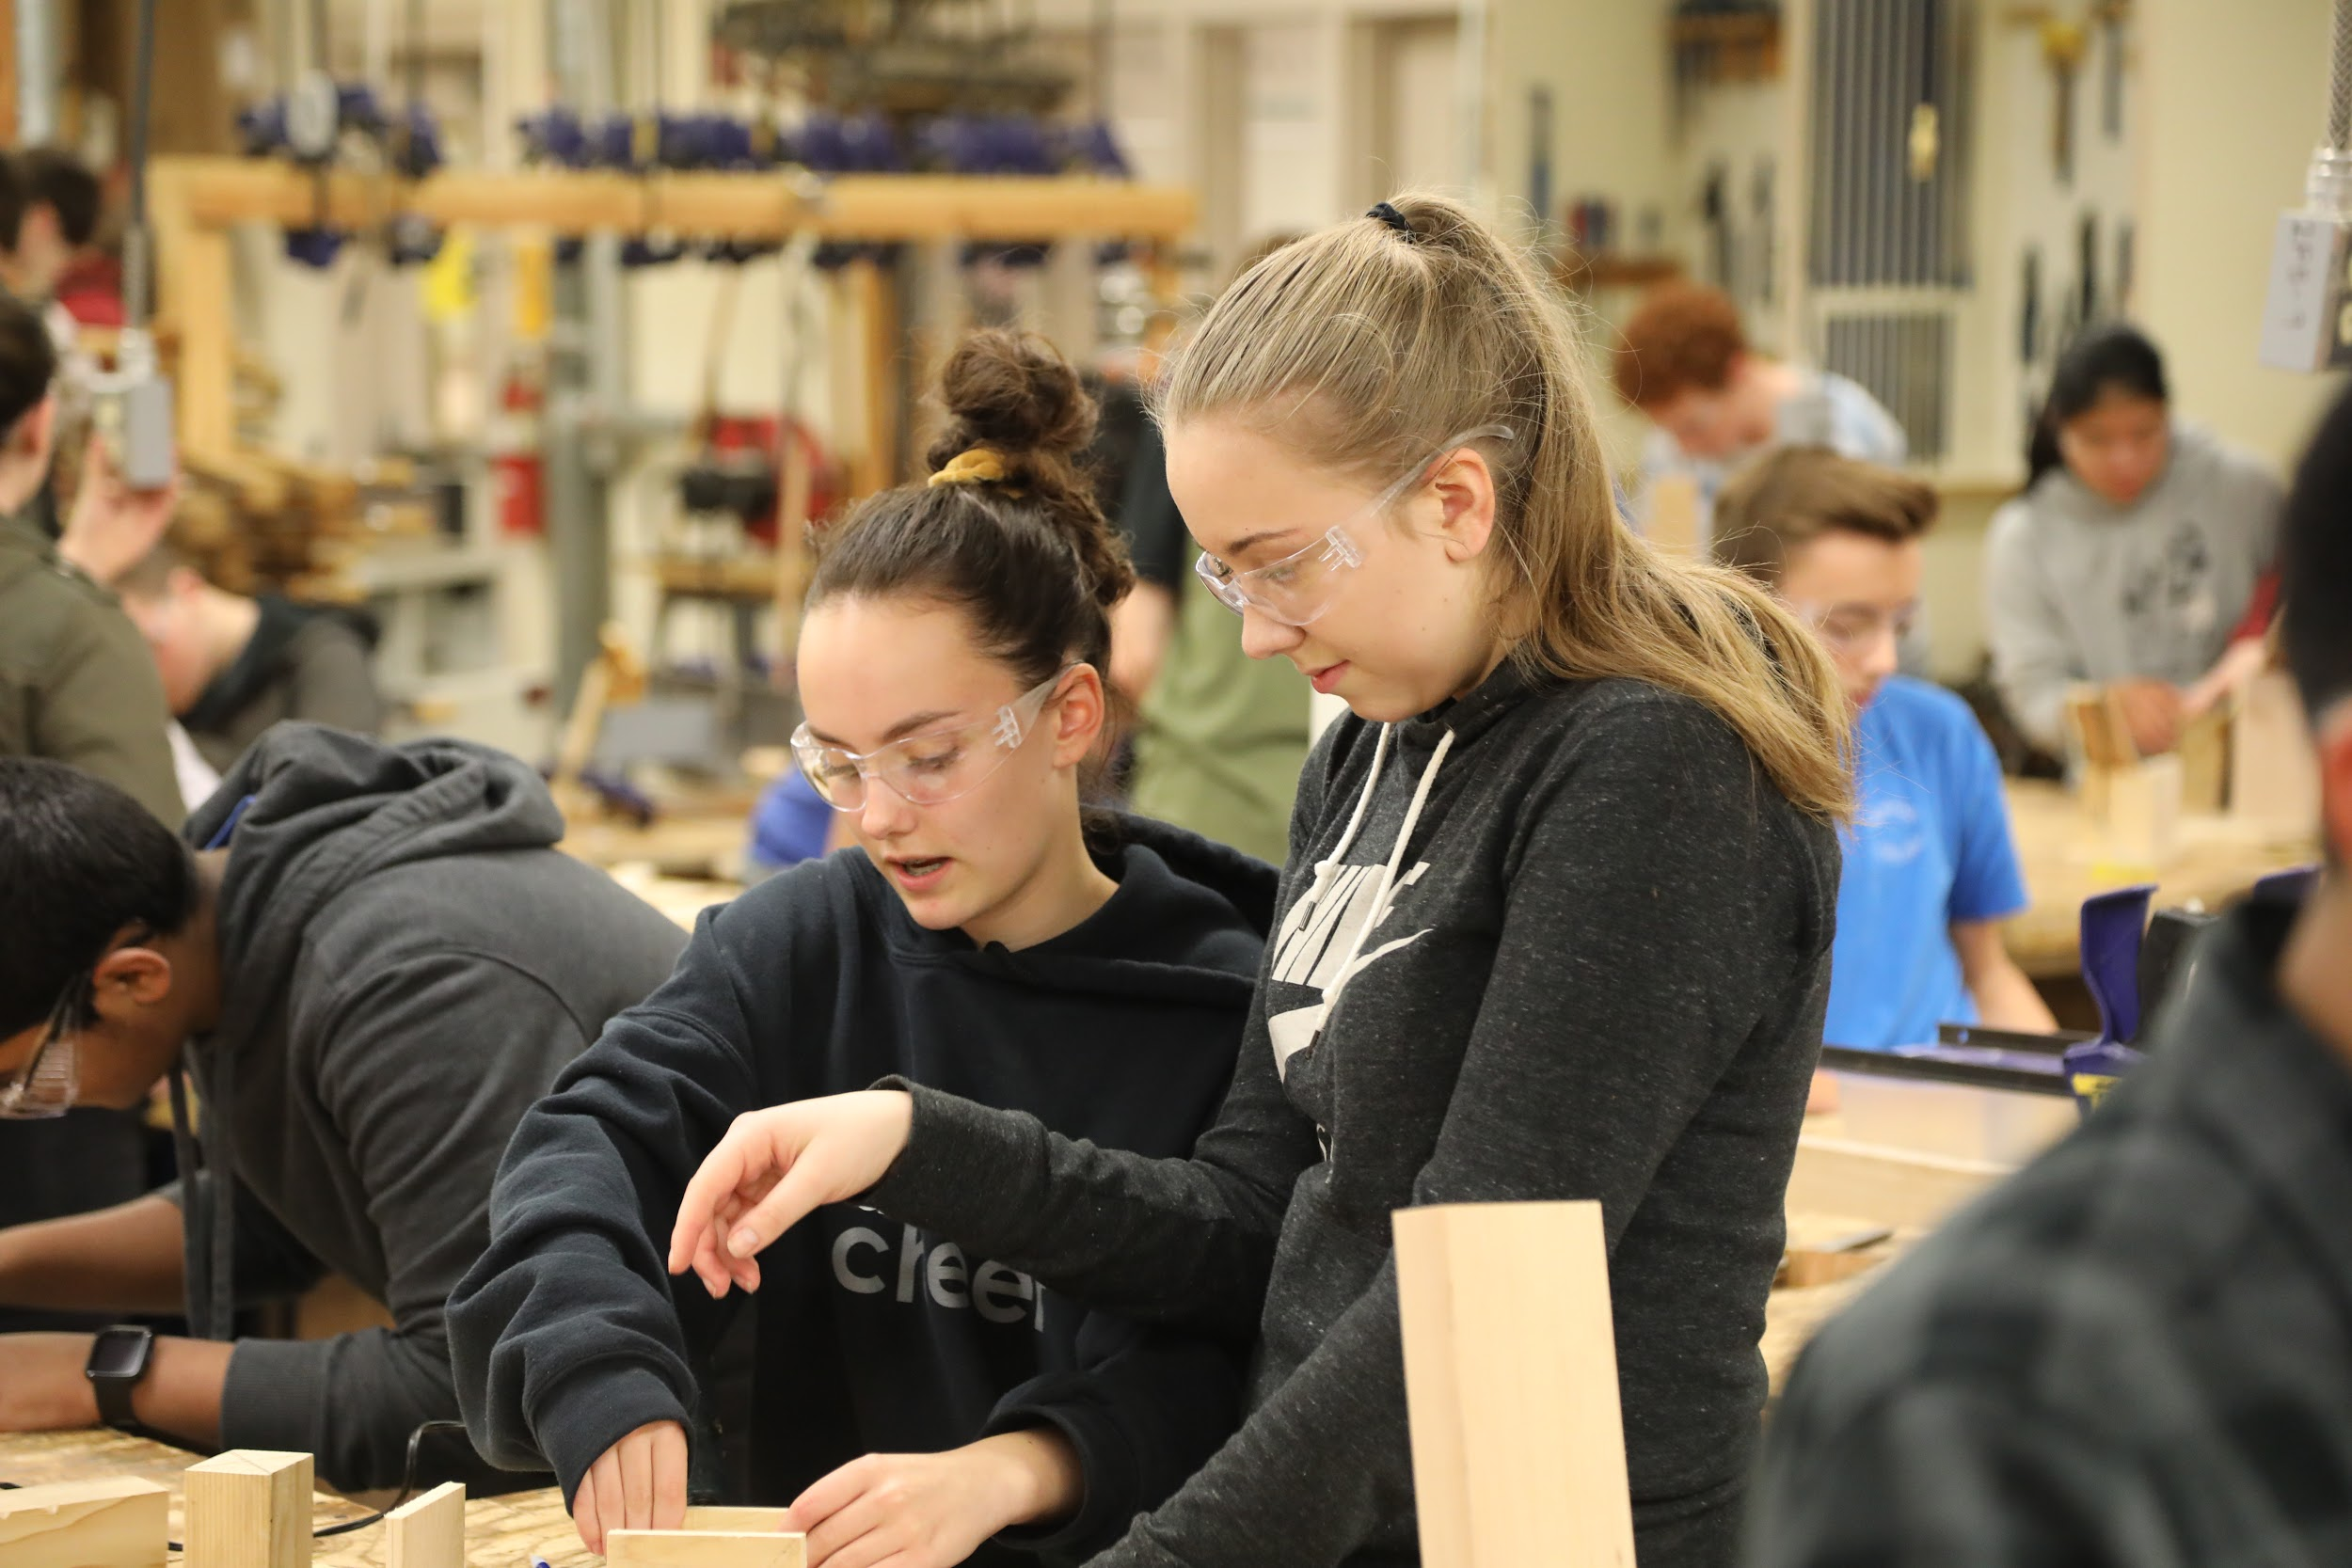
Goal 3. Real-World Learning
All students participate in real-world learning, with a global perspective, that prepares them for an ever-changing future. Student identity (race, culture, socioeconomic status, language, ability, gender, or sexual orientation) does not predict or predetermine success in school.

Slide 41
Mental Health (High School)

Slide 42
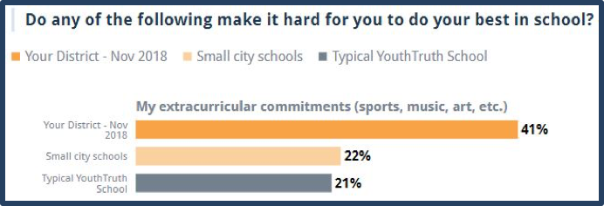
Community Findings (Middle School & High School)

Slide 43
Amens. Epiphanies. Questions. Feedback.
“I liked…”
“I learned…”
“I wonder…”
“I suggest…”

